Slide 1


Smart Shopping Through Machine Learning and Sentiment Analysis
Supervised by
Dr. Ahmed Hesham

Slide 2

It is an E-commerce project, but not like any regular E-commerce. It is E-commerce that gives you a recommendation for the product you want at the best price, best quality, and best reviews.

Slide 3
Any one of us will get an electronics product. The first thing he does is sit for a day or two searching on the internet on this site and start doing an analysis in his brain and come up with the best product, They always go to the most famous sites like Noon, Jumia and Amazon
From here the idea came to us that we make this topic easier for people and we start doing this analysis for them using Web scraping, Machine learning and Deep learning.

Slide 4

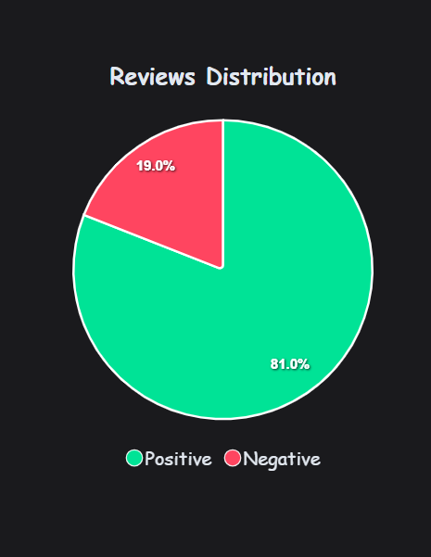
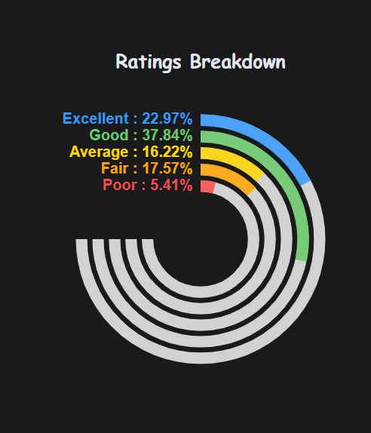
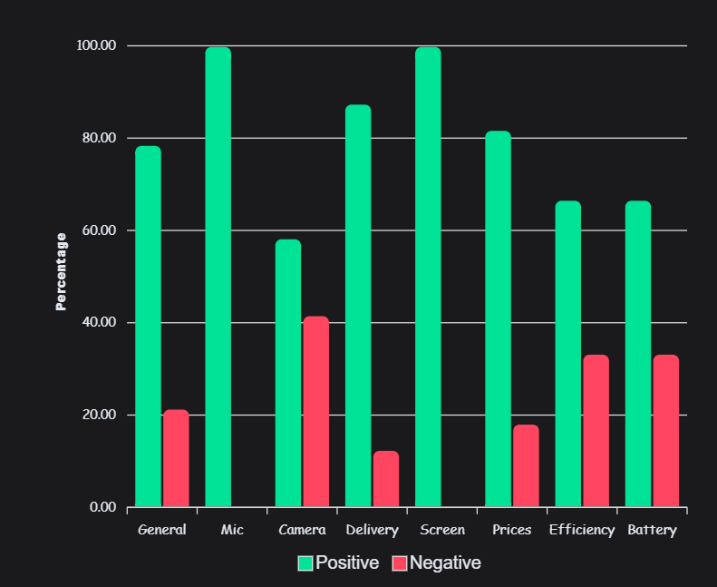
In short, the project thought that every time you enter the product, it will recommend you the best place (Noon, Amazon and Jumia) to buy it from with the highest quality at the lowest price. And he does an analysis of everything inside the product.
Ex: Battery, Efficiency, Mic, General, Camera, Delivery, Screen and Prices

Slide 5
Web-scraping

Slide 6



Web-scraping
Amazon
Noon
Jumia

Slide 7


Web-scraping
File
product
productReview
sellerReview

Slide 8
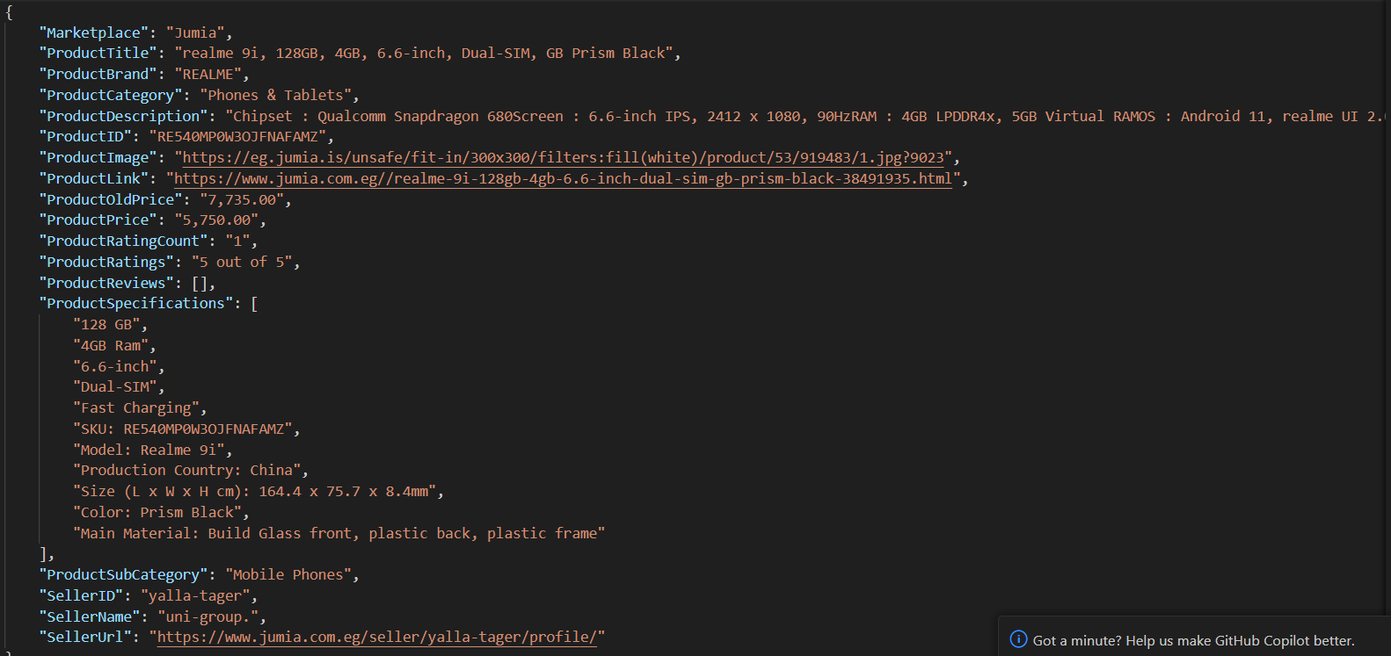
Web-scraping
Product.json

Slide 9
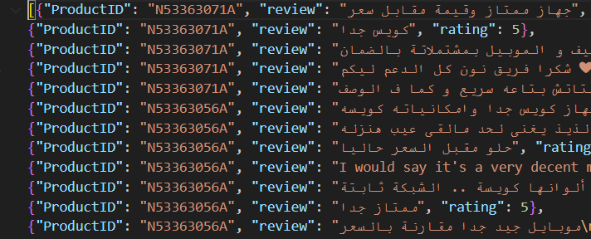
Web-scraping
ProductReview.json

Slide 10
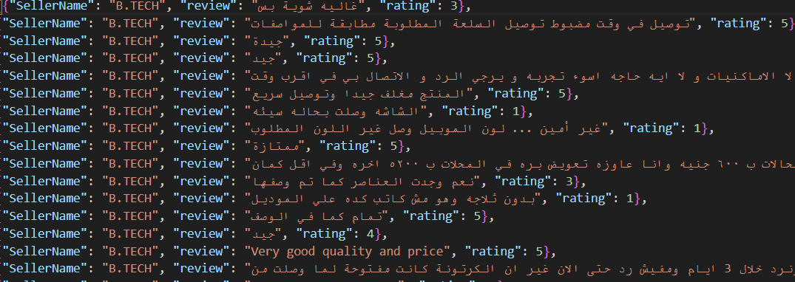
Web-scraping
sellerReview.json

Slide 11
Web-scraping
Attributes
product_name
product_link
product_ID
product_price
product_image
product_ratings
product_revCounts
OldPrice

Slide 12
Web-scraping
Attributes
product_name
product_link
product_ID
product_price
product_image
product_ratings
product_revCounts
OldPrice
Category
Sub_Category
product_spec
product_det
info_dic
Seller_Name
Seller_ID
Seller_Link
brand

Slide 13
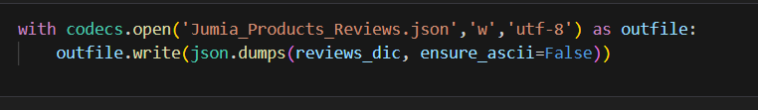
Web-scraping
Attributes
The scraped data was written into .json files as seen in the following code:
product_name
product_link
product_ID
product_price
product_image
product_ratings
product_revCounts
OldPrice
Category
Sub_Category
product_spec
product_det
info_dic
Seller_Name
Seller_ID
Seller_Link
brand

Slide 14
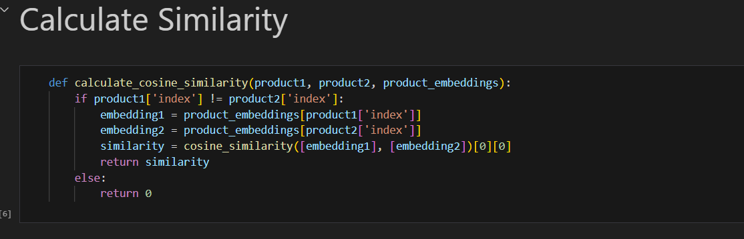
Web-scraping
Similarity
Cosine similarity: we used cosine similarity to compare between products to find matched products & suggest them to the user:

Slide 15
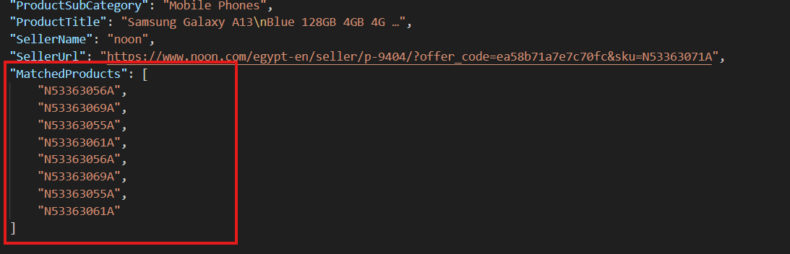
Web-scraping
Similarity
After using cosine similarity: New attribute is found “matchedProduct” by ID:

Slide 16
Web-scraping
We could have known the best of them without the intervention of machine learning, but this cannot be done.
Attributes
product_name
product_link
product_ID
product_price
product_image
product_ratings
product_revCounts
OldPrice
Category
Sub_Category
product_spec
product_det
info_dic
Seller_Name
Seller_ID
Seller_Link
brand
But we discovered that there are people who give the rating wrong.

Slide 17
Preprocessing

Slide 18

Preprocessing
Collecting Data about Reviews
We used Kaggle to obtain a dataset that contained both Arabic and English text. We then separated the data into two sets based on the language to train the model effectively on each language-specific dataset.

Slide 19
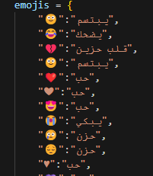
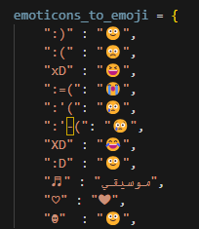
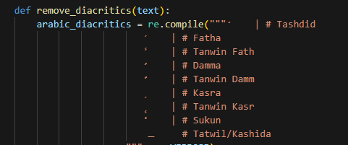
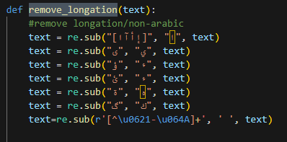
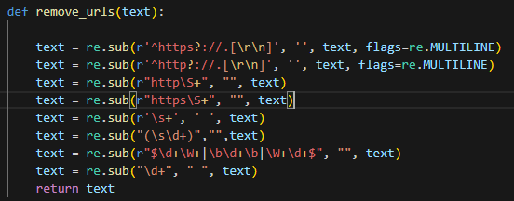
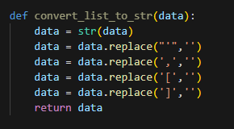
Arabic diacritics
Emojis
emoticons_to_emoji
remove_longation
remove_urls
convert list to str
These problems have impacted the accuracy negatively.

Slide 20
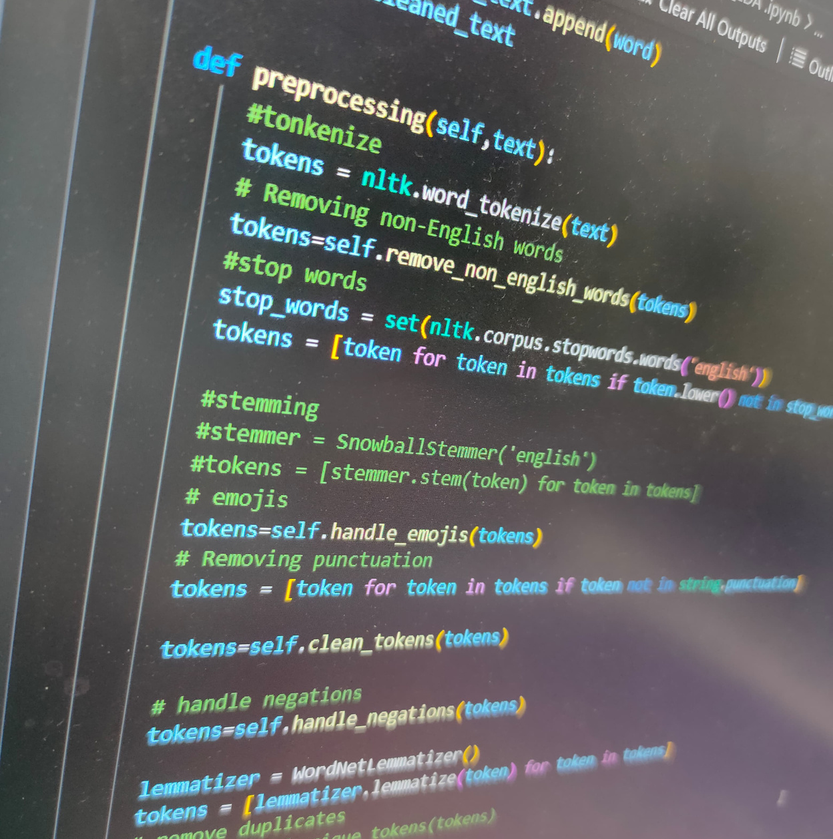
Preprocessing
Tokenization
Breaking text into smaller units, like words or sentences, to make it easier to process. For example, "I love coding" becomes ["I", "love", "coding"].

Slide 21
Preprocessing
Tokenization
Breaking text into smaller units, like words or sentences, to make it easier to process. For example, "I love coding" becomes ["I", "love", "coding"].
Lemmatization
Lemmatization: Reducing words to their base or dictionary form (lemma) while keeping the meaning. For example, "running" becomes "run".

Slide 22
Preprocessing
TF-IDF
TF-IDF (Term Frequency-Inverse Document Frequency) is a technique used in text analysis to measure how important a word is in a document compared to a collection of documents. It helps identify key words by balancing their frequency in a single document and across all documents
Convert text to numerical

Slide 23
Machine Learning

Slide 24
Machine Learning
Data
Training
Validation
Testing

Slide 25
Machine Learning
- | Training Acc. | Testing Acc. | Precision | Recall | F1_score
SVM | 98.13% | 92.46% | 92.46% | 92.46% | 92.46%
Random Forest | 99.61% | 89.92% | 89.92% | 89.92% | 89.92%
Multinomial Naive Bayes | 91.33% | 89.27% | 89.27% | 89.27% | 89.27%
Logistic Regression | 94.42% | 92.34% | 90% | 96% | 93%

Slide 26

Deep Learning
- | Accuracy | .H5
RNN | 90.2%
CNN | 90%
LSTM | 90.3%
BILSTM | 90.2%
Bidirectional GRU | 90.7%

Slide 27
Machine Learning

Slide 28
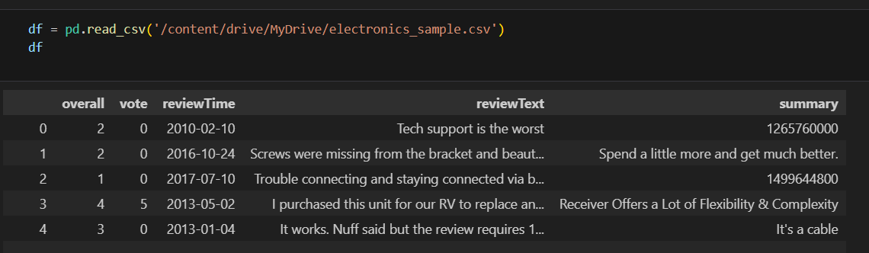
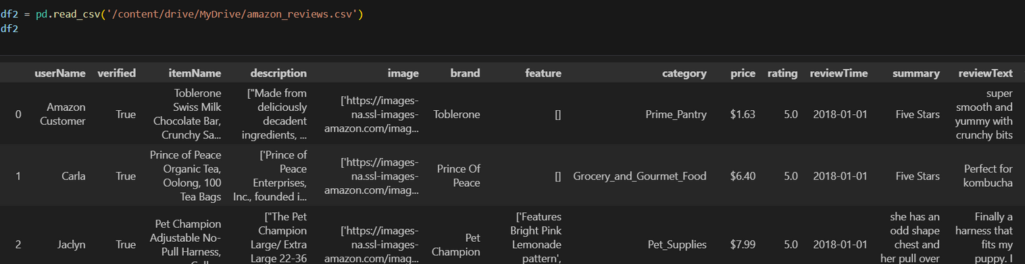
Electronics Sample dataset from Kaggle:
Amazon Reviews dataset from Kaggle:
And concatenate both.

Slide 29
Arabic diacritics
Emojis
emoticons_to_emoji
remove_longation
remove_urls
convert list to str
These problems have impacted the accuracy negatively.

Slide 30
Preprocessing
TF-IDF
TF-IDF (Term Frequency-Inverse Document Frequency) is a technique used in text analysis to measure how important a word is in a document compared to a collection of documents. It helps identify key words by balancing their frequency in a single document and across all documents
Convert text to numerical

Slide 31
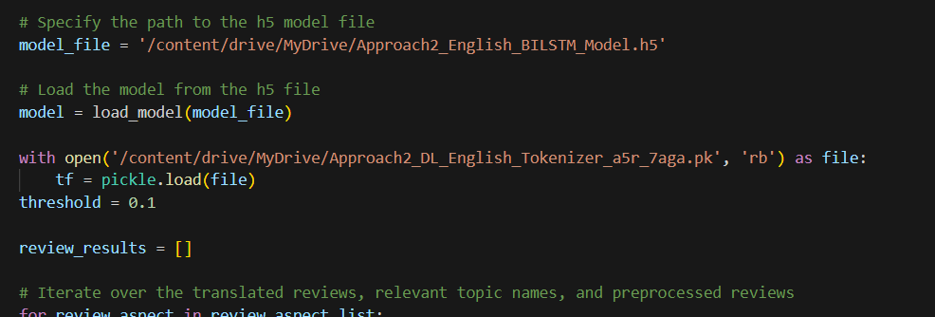
Machine Learning
To facilitate testing and avoid performance issues

Slide 32
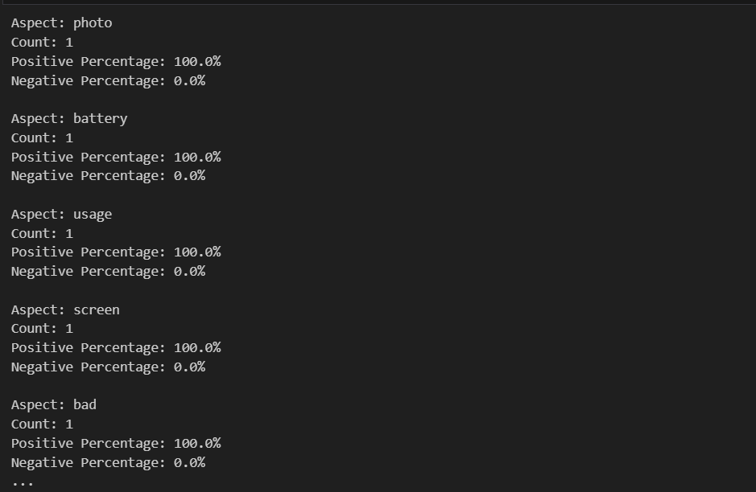
Machine Learning
Model output

Slide 33
Problem:Linking Machine learning and Backend

Slide 34
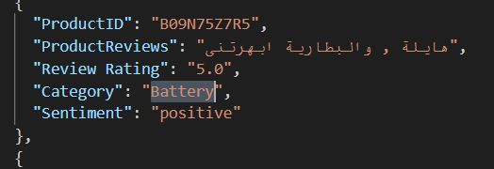
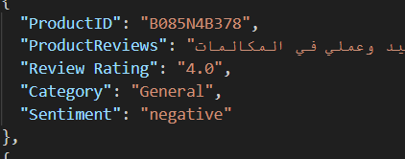
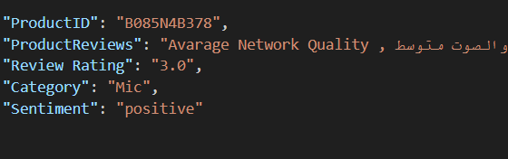
Machine Learning
This is what the data looks like after it was output from the model and placed in a json file.

Slide 35
Backend

Slide 36
Technologies Used
Node.js
Express.js
MSSQL

Slide 37
Backend
For our backend architecture, we prioritized high performance, minimalism, flexibility, and ease of customization. These principles ensure the system efficiently handles high traffic, utilizes resources optimally, adapts to future needs, and allows seamless modifications.
To achieve this, we selected Express.js for its minimalist, high-performance API capabilities and Microsoft SQL Server for its robust, scalable database management. This combination supports our goals of building a modern, efficient, and scalable backend solution.

Slide 38
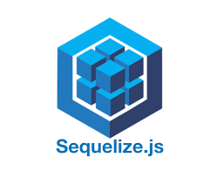
Backend
Sequelize
A powerful ORM (Object-Relational Mapping) tool that, along with its dependencies (sequelize-cli and tedious), streamlines database interactions and provides a clean abstraction layer for Microsoft SQL Server.

Slide 39
Backend
Why Sequelize?
There are other libraries like Mssql, but we choose sequalize for some reasons.
Sequalize avoid some errors that can happen in Mssql.

Slide 40
Backend
Aspects for Sequelize
Sequelize automatically maps JavaScript data types to the appropriate SQL data types(so it makes the creation of table easier and avoid errors in insertion process).
Abstraction Over SQL Queries:
Instead of writing raw SQL queries, you can use Sequelize's object-oriented methods to define models and perform operations, reducing the likelihood of syntax errors

Slide 41

Backend
Dotenv
Simplifies the management of environment variables, enhancing configuration flexibility and security.

Slide 42

Backend
Jsonwebtoken (JWT)
Used for generating and managing tokens, ensuring secure authentication and session management.

Slide 43
Backend
Handling scraped data
Our backend efficiently manages scraped data through machine learning preprocessing and mapping to the database schema. To maintain up-to-date information without overwriting existing data, we’ve automated the population of database tables. This automation triggers at server startup, filling tables if they are empty, ensuring data integrity and freshness.

Slide 44
Backend
Why we automated the population of database tables?
Our Project is based on data that has been scraped from many web stores so the data changes frequently, Therefore we automated the data insertion process to avoid inserting the datamanually every time the data changes.

Slide 45
Backend
User Authentication Requests
The backend manages user authentication through key requests:
Sign Up: Validates user input, creates accounts, and stores credentials securely.
Log In: Authenticates user credentials, generates a session token, and sends it to the frontend to maintain the session.
Log Out: Invalidates the session and discards the token, ensuring session security.
These requests ensure secure user management and protect access to the application’s resources.

Slide 46
Backend
Product Requests
Our backend supports key product-related interactions:
Search Products: Logged-in users can search for products using filters from the frontend.
Get Product by ID: When a product is selected, the system fetches detailed information and displays matched products.
What is matched products?
The scrapped data have many similar data(there is fully similar data and not entirely similar data that differ in some features).

Slide 47
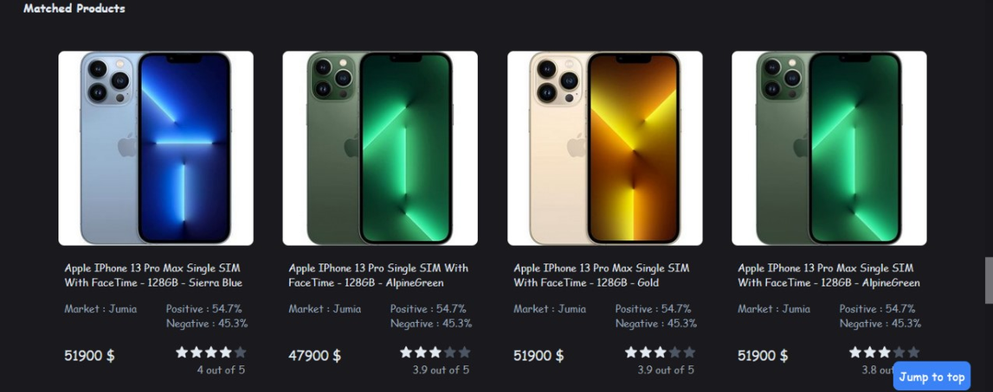
Backend
Product Requests
So we put the similar data in table in the data base called matched products , so when the client choose specific product we will show the similar products for him (this similar products can be different in specific feature like the price or the screen or anything else), so he can see all the choices for this specific product in front of him.
Why is this feature is exist?
To makethe client can see all the choices because may be there is the same product from different store but with a lower price or there is afeature stronger in the same product but in another store with same price.

Slide 48
Backend
Product Requests
Our backend supports key product-related interactions:
Seller Analysis: Alongside product details, users receive insights about the seller, enhancing their decision-making process.

Slide 49
Backend
Wishlist requests
The wishlist feature allows users to save products they like for future reference. Here's how it works in our backend:
1. getWishlist
Purpose: Displays the products users have saved in their wishlist.
How it Works: Retrieves the list of products from the database and shows details like name, price, and availability.
2. addToWishlist
Purpose: Enables users to add products to their wishlist.
How it Works: Adds the product to the wishlist if it isn’t already there and confirms the addition.
3. deleteFromWishlist
Purpose: Lets users remove products from their wishlist.
How it Works: Deletes the selected product from the wishlist and updates the list accordingly.

Slide 50
Frontend

Slide 51
Frontend
Research and Analysis
User Research: Understanding the target audience, their needs, behaviors, and pain points through surveys, interviews, and user personas.
Market Research: Analyzing competitors and industry trends to identify opportunities and best practices.
Requirement Gathering: Collecting functional and non-functional requirements to define the website's objectives.

Slide 52
Frontend
Research and Analysis
Requirements
User Research: Understanding the target audience, their needs, behaviors, and pain points through surveys, interviews, and user personas.
Market Research: Analyzing competitors and industry trends to identify opportunities and best practices.
Requirement Gathering: Collecting functional and non-functional requirements to define the website's objectives.
Authentication
Viewing Products
Searching Products
Filtering Products
...

Slide 53
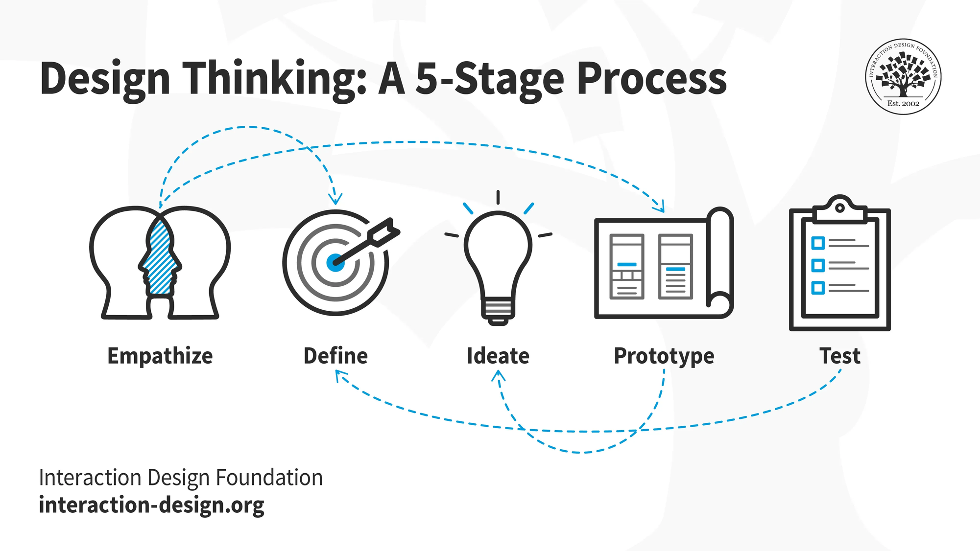
Frontend

Slide 54
Frontend
Design Process
Wireframing
Initial sketch of the layout to visualize the structure and flow of the website.
Helps in identifying the placement of elements like headers, navigation menus, content sections, and footers.

Slide 55
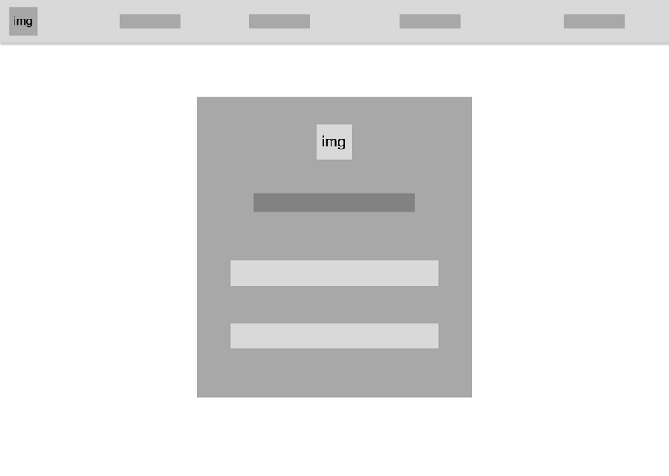


Frontend

Slide 56
Technologies Used
HTML
CSS
JavaScript
React

Slide 57

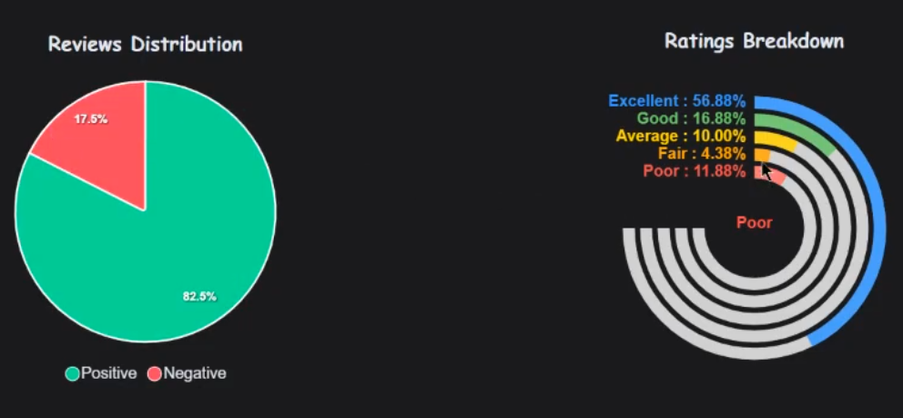
Libraries
ApexCharts

Slide 58
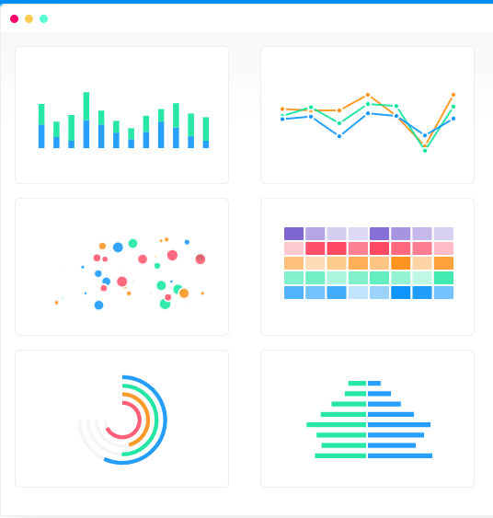
Libraries
ApexCharts
ApexCharts is known for its ease of integration, responsiveness, and customization options, making it a popular choice for developers who need to incorporate dynamic visual data representations into their projects. It also supports animations, tooltips, and event handling, enhancing the user experience.

Slide 59
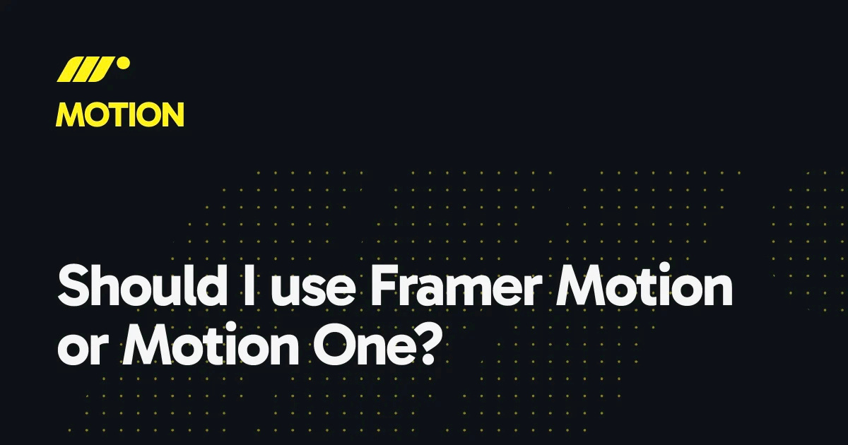
Libraries
Framer Motion

Slide 60

Libraries
Frame Motion
Frame Motion is a powerful animation library for React that simplifies the creation of smooth, fluid animations. It uses a declarative syntax to define animations, supports gestures like drag and hover, and offers features like keyframes, variants for managing multiple states, and layout animations for smooth transitions. With its ease of integration and extensive customization options, Frame Motion is ideal for enhancing user interfaces with dynamic, engaging motion effects.

Slide 61
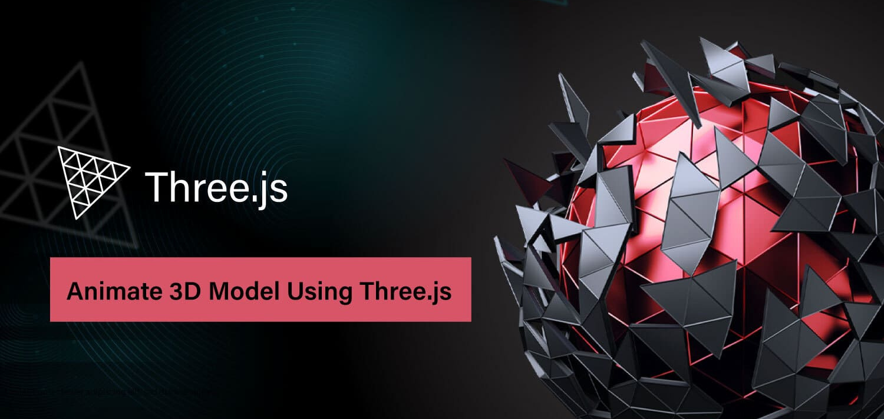
Libraries
Three.js

Slide 62
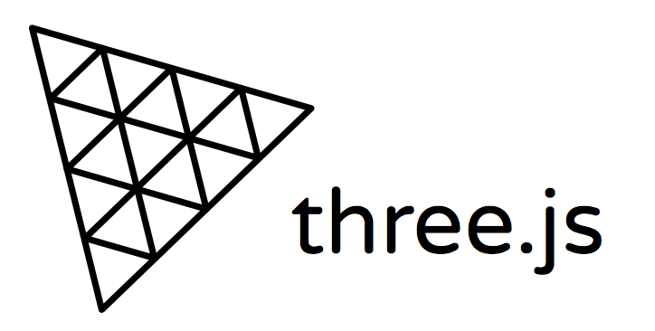
Libraries
Three.js
Three.js is a powerful JavaScript library that simplifies the creation of 3D graphics in the browser. It provides an easy-to-use API for rendering complex 3D scenes, including support for various geometries, materials, lights, and cameras. Three.js also handles WebGL under the hood, making it accessible for developers without deep graphics programming knowledge. With features like animations, shadows, textures, and post-processing effects, Three.js is widely used for building interactive 3D experiences, from simple visualizations to advanced virtual reality applications.

Slide 63
Problems with Frontend

Slide 64
Problems with Frontend
Challenge with P5 JS
Heavy Rendering Operations: p5.js is ideal for quick sketches and creative coding, but its performance can degrade with complex scenes involving many objects, animations, or intricate visual effects, leading to frame rate drops or lag.
2D Rendering Issues: Even with the WebGL renderer, p5.js may not be fully optimized for highly complex scenes typical in 3D applications.
Memory Management: p5.js lacks built-in memory optimizations for managing large, dynamically created objects or resources, which can result in performance bottlenecks during large-scale visuals or animations.

Slide 65
Problems with Frontend
Why Three.js Outperforms p5.js for Heavy Scenes:
Hardware Acceleration: Utilizes WebGL for GPU-powered rendering, enhancing performance over p5.js, which may not fully leverage the GPU for 3D tasks.
Optimized for 3D Graphics: Provides better control and optimizations for 3D objects, cameras, lighting, shaders, and materials, making it more efficient for complex 3D scenes.
Efficient Scene Graph: Manages scenes through a scene graph, optimizing transformations, culling, and updates, improving performance in dynamic environments.
Advanced Optimizations: Features like level of detail (LOD), instancing, and efficient texture management help maintain high frame rates in complex scenes.
WebGL Context Control: Offers lower-level control for fine-tuning and optimizations, such as geometry batching and custom shaders, enhancing rendering efficiency.
Physics and Interactivity: Integrates well with physics libraries like Cannon.js or Ammo.js for high-performance simulations, unlike p5.js, which may lag with similar tasks.

Slide 66
Problems with Frontend
Challenges of Using ApexCharts and Framer Motion with React JS
ApexCharts:
Complex Configurations: Numerous customization options can be challenging to configure, especially for dynamic and complex charts.
Performance with Large Data Sets: Large datasets may cause performance issues, requiring optimization techniques like lazy loading or chart throttling.
Integration with Other Libraries: Integrating with React Router or state management libraries can be tricky, particularly when updating charts with dynamic data.
Responsiveness: Additional configuration may be needed to ensure charts are responsive across various screen sizes.

Slide 67
Problems with Frontend
Challenges of Using ApexCharts and Framer Motion with React JS
Framer Motion:
Performance Issues: Overuse of animations can degrade performance in large or complex React applications, causing slower render times and UI lags.
Learning Curve: Understanding the API and handling advanced animations like drag-and-drop or scroll-based animations can be challenging.
Debugging Animations: Troubleshooting unexpected animation behavior can be difficult, especially when dealing with CSS or React component states.
Browser Compatibility: Ensuring smooth animations across all browsers, including older versions, can be a challenge due to varying support for CSS features.

Slide 68







Team Members
Yousef Ahmed
Bassant Atef
Zyad Ellethy
Frontend
Frontend
UI/UX
Maro Adel
Seifallah Hassan
Abdelrahman Ahmed
Machine
Learning
Backend
Backend

Slide 69
Thank you

